Slide 1
Tokyo Real Estate

Slide 2
Dataset
Source: https://www.kaggle.com/datasets/nishiodens/japan-real-estate-transaction-prices/data
Real estate transactions from 47 prefectures in Japan
Collected between 2005 and 2019
Almost 4 million entries
Tokyo Dataset contains over 400,000 entries
Notes:
So the Dataset I used for this project is the Japan Real Estate sales Dataset found on Kaggle, Ive included the link to the source on the slides. This is a dataset contain real estate sales form all 47 prefectures in Japan from the years 2005 to 2019. This dataset contained almost 4 million entries and I opted to use just the Tokyo prefecture data due to memory limitations. Even then the Tokyo section of the dataset still contained over 400k entires.

Slide 3
Dataset
Summary of Fields
Type
TradePrice
Area
Frontage
TotalFloorArea
FloorAreaRatio
Notes:
In the dataset these are some of the more notable features,
Type is the type of real estate such as farmland or residential land
Trade price is the target of the model
Area being the area in m^2 for the real estate
Frontage is the distance between the front of any house to the road, this feature was missing some points since apartments would have no frontage
Total floor area is the area of the house or apartment and not the plot size
Floor Area Ratio is as it sounds the ratio of floor space to area, this feature is important as its more complete in the dataset than total floor area

Slide 4
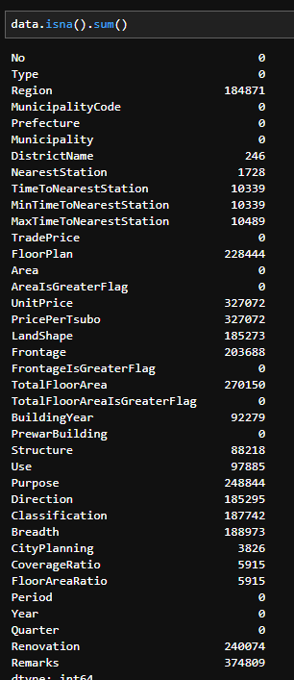
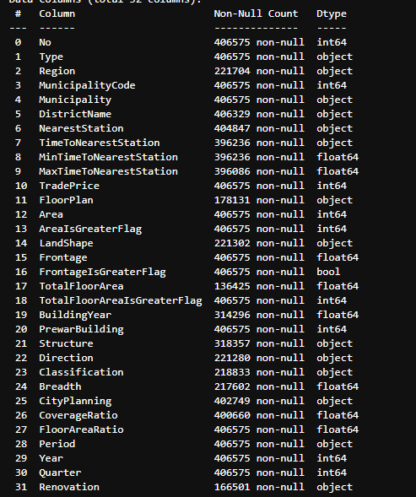
Preliminary Analysis
Notes:
in terms of preliminary analysis, the first things I looked into were the incomplete features as removing unnecessary features. I deemed features such as Unit price and price per Tsubo unnecessary as they would be directly calculated from the target. Features such as Prefecture are irrelevant in this analysis since the focus is specifically Tokyo prefecture instead of all 47, Additional features such as Remarks, Purpose and use were either too incomplete or doesn’t contain any useful information.

Slide 5
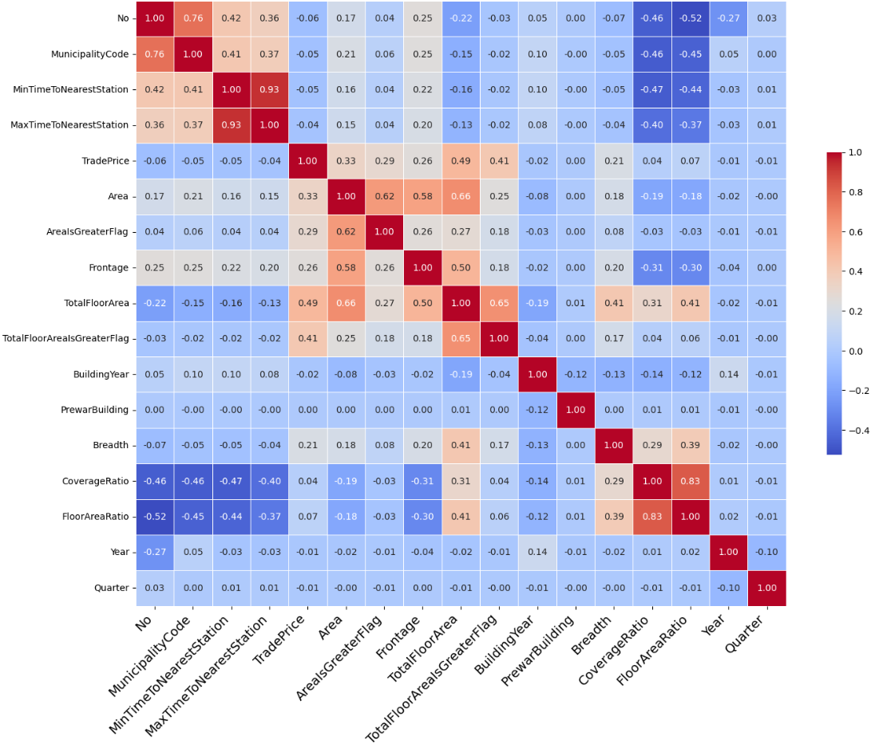
Correlation Matrix
Notes:
After cleaning up some of the features, I wanted to see which features had the highest correlations with my target, as expected most numerical features had little to no correlation with the target. It could be seen that the features with the highest levels of correlation would be total floor area and trade price.

Slide 6
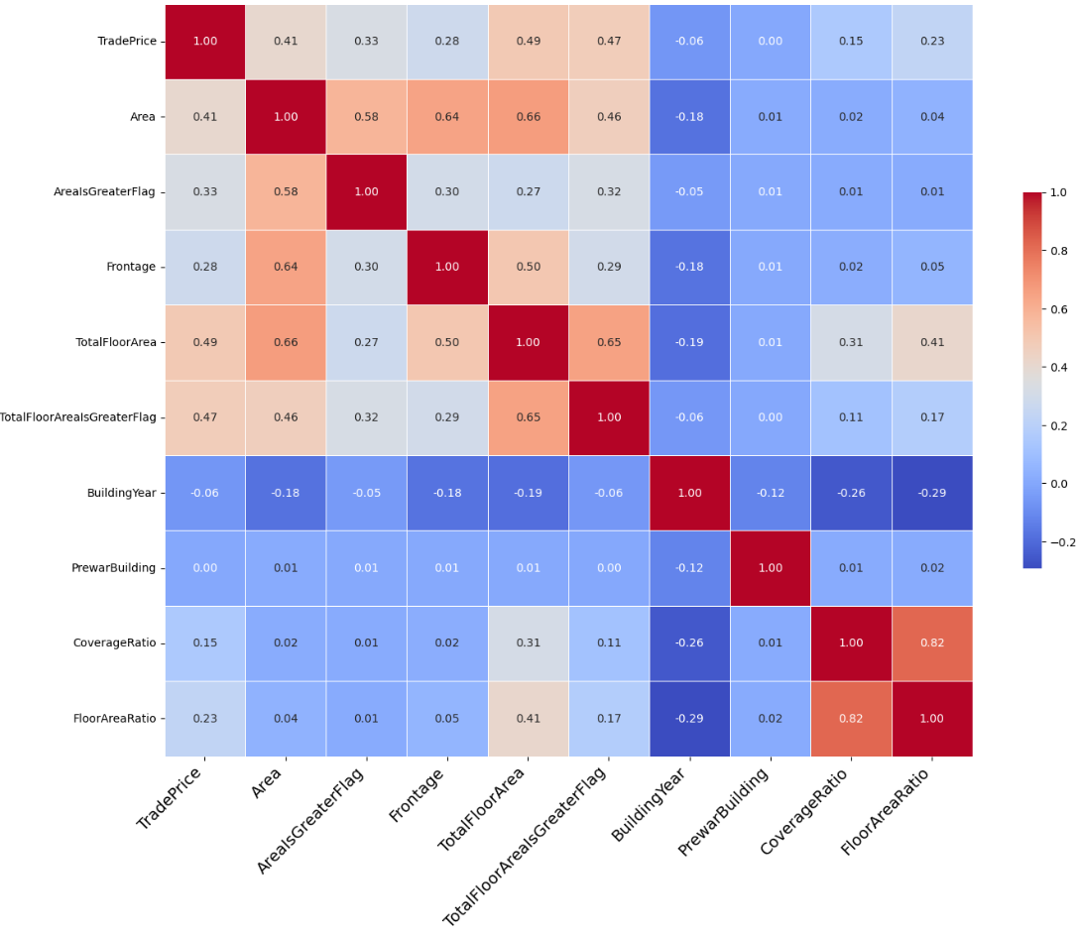
Correlation Matrix
Notes:
Here I have another correlation matrix with some variables removed this time. You can see that the correlation between trade price and some other features are higher in this plot, I opted to look into if specific categorical features such as land type had any impact in the dataset. This matrix was generated by only looking at residential buildings. This could indicate that categorical features could play a role in the model.

Slide 7
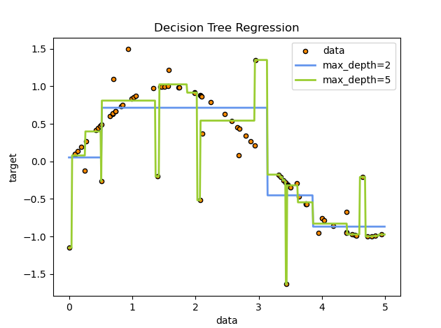
Model Selection
Notes:
In terms of model selection, after reviewing the correlation matricies I knew that categorical variables could play a role in the final model, so I opted to go with a the decision tree regression model over a linear regression. Decision tree was selected was due to the fact that it could handle categorical variables better than that of linear regression, some of the features also have a good chunk of missing values, for missing values if I were to use linear regression I would need to find a way to clean the data to remove all missing values or just delete rows with missing values which would shrink the dataset.

Slide 8

Training the model
Area as a baseline score of 0.14
Notes:
I started training my model only 1 feature being area to get a baseline for the training and test scores, what I ended up with was a training score of around 0.15 and a testing score of 0.17, since the trsting score was actually higher than the training score it showed that the model generalized in the testing than when it was training

Slide 9
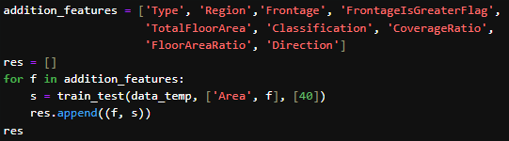
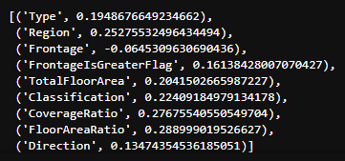
Training the Model
Notes:
I proceeded to test how my test scores would change based on each of the additional features I added into the model, since my main focus is testing scores and not training scores, after about 3 iterations, the score had little to no changes. If the primary focus was training scores I would likely be able to get it much higher

Slide 10
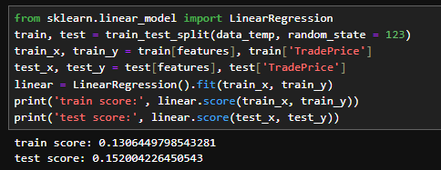
Alternative Model
Notes:
One last test I conducted before finalizing my model was test the features I selected based on the previous to run a linear regression test, I originally selected Decision trees since I thought it might have to handle categorical features better, after selecting features, none of the selected features are categorical variables so I wanted to see how it performs in a linear regression. But looking at the results from the linear regression it can be seen the decision trees did perform better at least with the selected features.

Slide 11
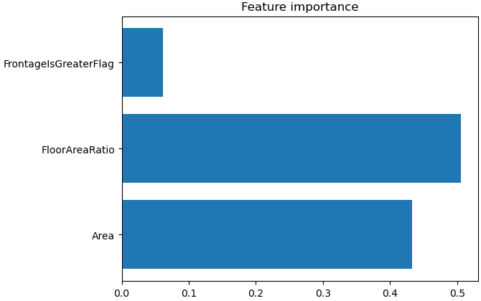

Final Model
Notes:
Using the steps mentioned before I concluded best model used only 3 features those being frontage flag which mean if the frontage of the real estate is greater than 50 meters, the area of the plot and the floor to area ratio. With these factors I ended up getting a training score of around 0.5 and a test score of 0.31. even though the training score is rather low and I was able to get it much higher, no matter what features I tried adding would increase the test score any futher, in fact most features ended up decreasing the test score which could mean overfitting.

